Slide 1
Project report on Bank Management System
SUMIT THAKUR
​

Slide 2
AGENDA
Introduction​
Abstract
​Aim of this project
How it woks
Main Goals
Methods
Screen shorts
Administrative Modules
​Summery

Slide 3

Introduction
The “Bank Account Management System” project is a model Internet Banking Site. This site enables the customers to perform the basic banking transactions by sitting at their office or at homes through PC or laptop. The system provides the access to the customer to create an account, deposit/withdraw the cash from his account, also to view reports of all accounts present. The customers can access the banks website for viewing their Account details and perform the transactions on account as per their requirements. With Internet Banking, the brick and mortar structure of the traditional banking gets converted into a click and portal model, thereby giving a concept of virtual banking a real shape. Thus, today's banking is no longer confined to branches. E-banking facilitates banking transactions by customers round the clock globally.
The primary aim of this “Bank Account Management System” is to provide an improved design methodology, which envisages the future expansion, and modification, which is necessary for a core sector like banking. This necessitates the design to be expandable and modifiable and so a modular approach is used in developing the application software.
This Photo by Unknown Author is licensed under CC BY

Slide 4
Abstract
The Bank Account Management System is an application for maintaining a person's account in a bank. In this project I tried to show the working of a banking account system and cover the basic functionality of a Bank Account Management System. To develop a project for solving financial applications of a customer in banking environment in order to nurture the needs of an end banking user by providing various ways to perform banking tasks. Also, to enable the user’s work space to have additional functionalities which are not provided under a conventional banking project.

Slide 5
Abstract
The Bank Account Management System undertaken as a project is based on relevant technologies. The main aim of this project is to develop software for Bank Account Management System. This project has been developed to carry out the processes easily and quickly, which is not possible with the manuals systems, which are overcome by this software. This project is developed using Java language. Creating and managing requirements is a challenge of IT, systems and product development projects or indeed for any activity where you have to manage a contractual relationship. Organization need to effectively define and manage requirements to ensure they are meeting needs of the customer, while proving compliance and staying on the schedule and within budget

Slide 6
abstract
The impact of a poorly expressed requirement can bring a business out of compliance or even cause injury or death. Requirements definition and management is an activity that can deliver a high, fast return on investment. The project analyzes the system requirements and then comes up with the requirements specifications. It studies other related systems and then come up with system specifications. The system is then designed in accordance with specifications to satisfy the requirements. The system design is then implemented with Java. The system is designed as an interactive and content management system. The content management system deals with data entry, validation confirm and updating whiles the interactive system deals with system interaction with the administration and users. Thus, above features of this project will save transaction time and therefore increase the efficiency of the system

Slide 7
Aim of project
The main aim of designing and developing this Internet banking System Java primarily based Engineering project is to provide secure and efficient net banking facilities to the banking customers over the internet. Apache Server Pages, MYSQL database used to develop this bank application where all banking customers can login through the secured web page by their account login id and password. Users will have all options and features in that application like get money from western union, money transfer to others, and send cash or money to inter banking as well as other banking customers by simply adding them as payees

Slide 8
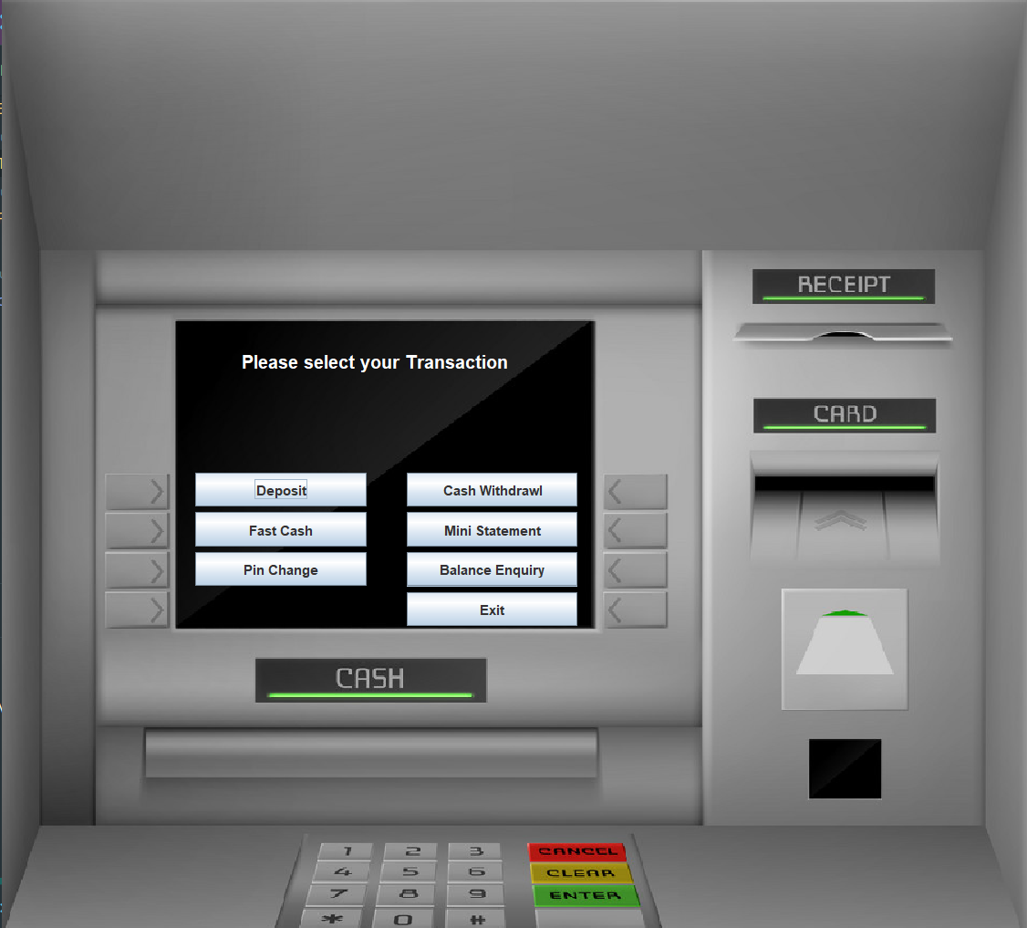
How it works
It is a Desktop based application. Details of client information will be saved in my SQL database and can be fetched on requirements. This application makes connection to my sql database to fetch credentials of client. Client needs to SIGNIN first .After successful signin A card no and pin will be generated . Using those card no and pin client can log in to their account. After successful login a Transaction window will appear. There will be seven options in Transaction window i.e Deposit, Cash Withdrawl, Fast Cash, Mini Statement, Pin change, Balance Enquiry and Exit Clients can choose the services according to their requirements.

Slide 9
Main goal
Motto:
Our motto is to develop a software program for managing the entire bank process
related to Administration accounts customer accounts and to keep each every track about
their property and their various transaction processes efficiently.
Hereby, our main objective is the customer’s satisfaction considering today’s faster in the world.
OTHER GOALS INCLUDE
CUSTOMER SATISFACTION
SAVING CUSTOMER TIME
PROTECTING THE CUSTOMER
TRANSFERRING MONEY

Slide 10
METHODS
We need to be able to generate an account number
Account types: Savings or Current Account
Maintain/update Balance
Open/Close Account
Withdraw/Deposit

Slide 11
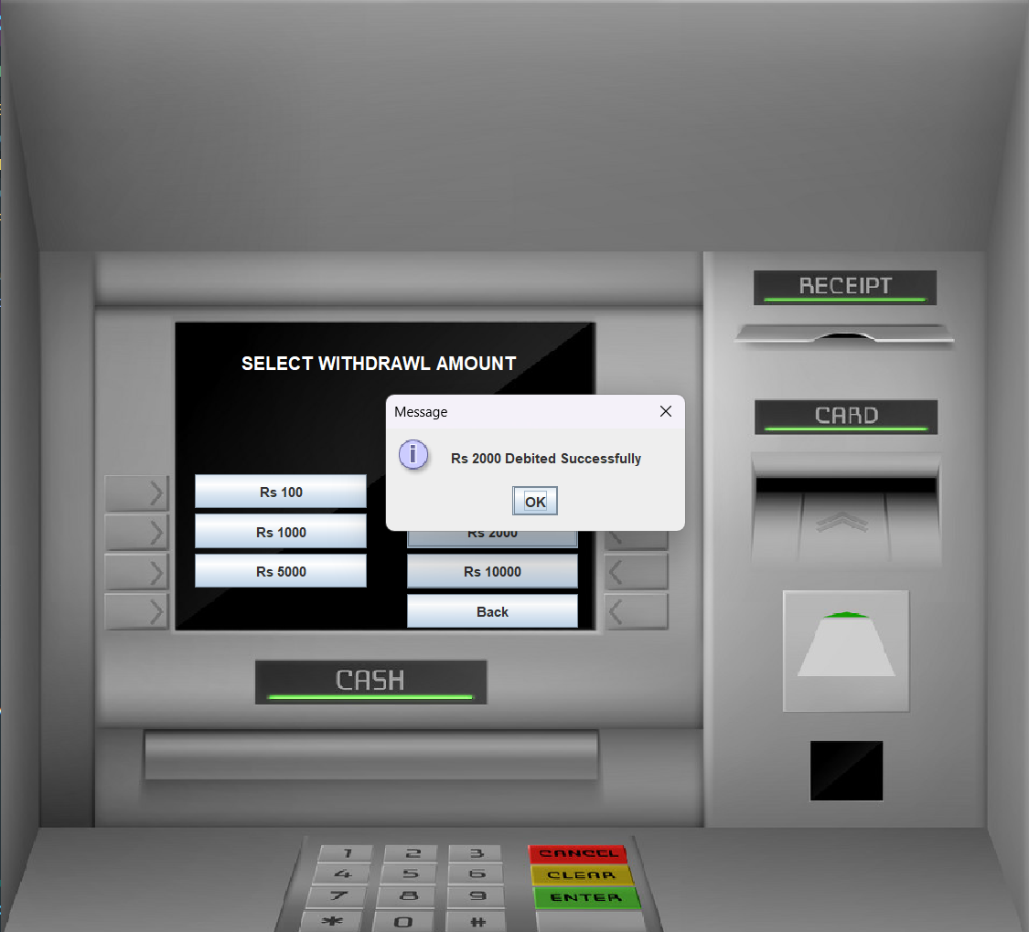
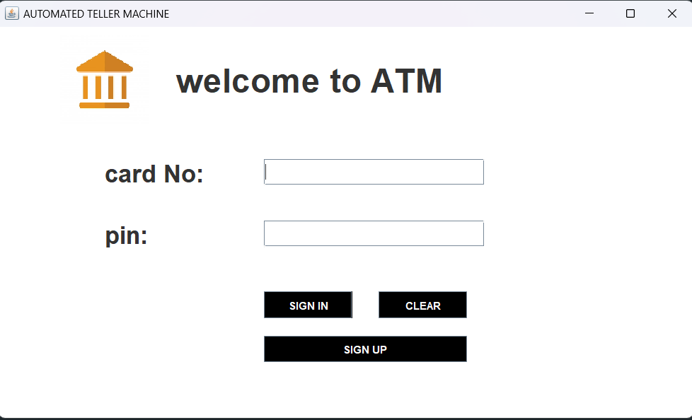
Screen shorts

Slide 12
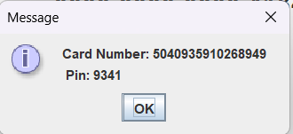
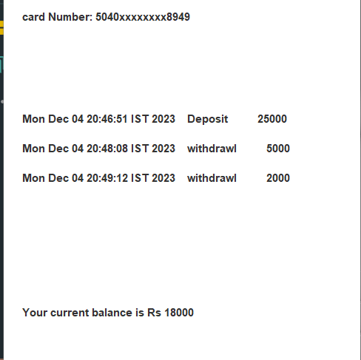
screenshorts
Card and pin gen.
Transactions​
Mini statement
Login page
Enter card details to login
Generating card and pin no
Choose Transactions
Mini statement slip

Slide 13
Administrative modules
Admin module
User module
A simple user can access their account and can deposit/withdraw money from their account. User can also transfer money from their account to any other bank account. User can see their transaction report and balance enquiry too.
1- User login, use PIN system
2- Creating/open new account registration
3- Funds transfer (local/international/domestic)
4- View statements transaction
5- User account details
6- Change Password and Pin
Admin can access this project there is an authorization process. If you login as an Admin then you will be redirected to the Admin Home Page and if you are a simple user you will be redirected to your Account Home Page. This performs the following functions: Create Individual Accounts, manage existing accounts, View all transactions, Balance enquiry, Delete/close account etc.
1- Admin login
2- Add/delete/update account
3- Withdrawal/deposit/statements transaction
4- Account Information
5- User details list
6- Active/Inactive account
7- View transaction historie

Slide 14
SUMMARY
This project is developed to nurture the needs of a user in a banking sector by embedding all the tasks of transactions taking place in a bank. Future version of this project will still be much enhanced than the current version. Writing and depositing checks are perhaps the most fundamental ways to move money in and out of a checking account, but advancements in technology have added ATM and debit card transactions. All banks have rules about how long it takes to access your deposits, how many debit card transactions you're allowed in a day, and how much cash you can withdraw from an ATM. Access to the balance in your checking account can also be limited by businesses that place holds on your funds.

Slide 15
summery
Banks are providing internet banking services also so that the customers can be attracted. By asking the bank employs we came to know that maximum numbers of internet bank account holders are youth and business man. Online banking is an innovative tool that is fast becoming a necessity. It is a successful strategic weapon for banks to remain profitable in a volatile and competitive marketplace of today. If proper training should be given to customer by the bank employs to open an account will be beneficial secondly the website should be made friendlier from where the customers can directly make and access their accounts. Thus, the Bank Management System it is developed and executed successfully.

Slide 16
THANK YOU
Sumit Thakur
sumitthakur6500@gmail.com
Contact:+919939448453

